Slide 1
DANANG BUS ROUTES FINDER “DANABUS"
Group member:
Lê Trọng Hiếu
Nguyễn Định An
Trương Thị Vân Anh
Trần Viết Anh Quốc

Slide 2
Section 1. Project Overview
1
Project Overview
5
Quality Management
2
Project Organization
6
Project Transition
3
Project Start-up
7
References
4
Monitoring and Control
8
Glossary
2/46

Slide 3
Section 1. Project Overview
A
Project Description
C
Project Scope
B
Assumptions
D
Constraints
3/46

Slide 4




Section 1. Project Overview
Stakeholder
Danang Government
Danang Department of Transportation
Danang ICT Infrastructure Development Center
AHAQ High Tech Software Ltd.
4/46

Slide 5

Section 1. Project Overview
Problem
Citizens are still not really impressed by public transport systems
Environmental pollution, noise pollution, traffic jams, traffic accidents, etc…
Need a solution to enhance the number of bus users

Slide 6
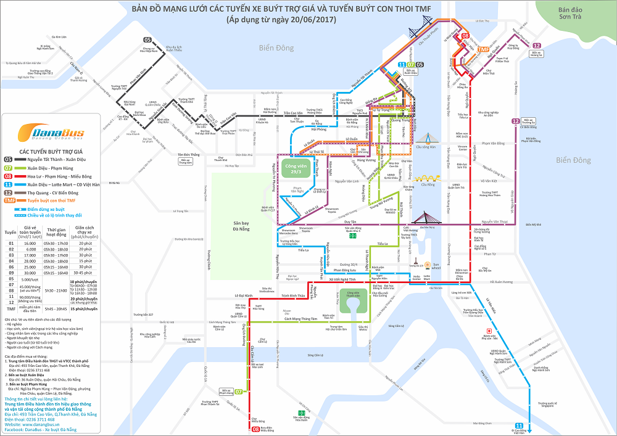
Section 1. Project Overview
“Danabus” Application
Help users know detailed information about bus.
Find the optimal route from starting point and end point.
6/46

Slide 7
Section 1. Project Overview
Project Scope
Application: run on mobile devices only, iOS 9.0 or above, Android 5.0 or above
Language: Vietnamese & English
Connection: Internet & GPS
Main features:
Find routes
Estimate waiting time
Look up information,
Find bus stop
Update data
Feedback
7/46

Slide 8
Section 1. Project Overview
Assumptions
Resource Assumptions
Technology assumptions
Business assumptions
Financial assumptions
Constraints
Schedule constraints
Scope constraints
Cost constraints
8/46

Slide 9
Section 2. Project Organization
A
Internal Structure
B
External Stakeholders
C
Roles and Responsibilites
9/46

Slide 10
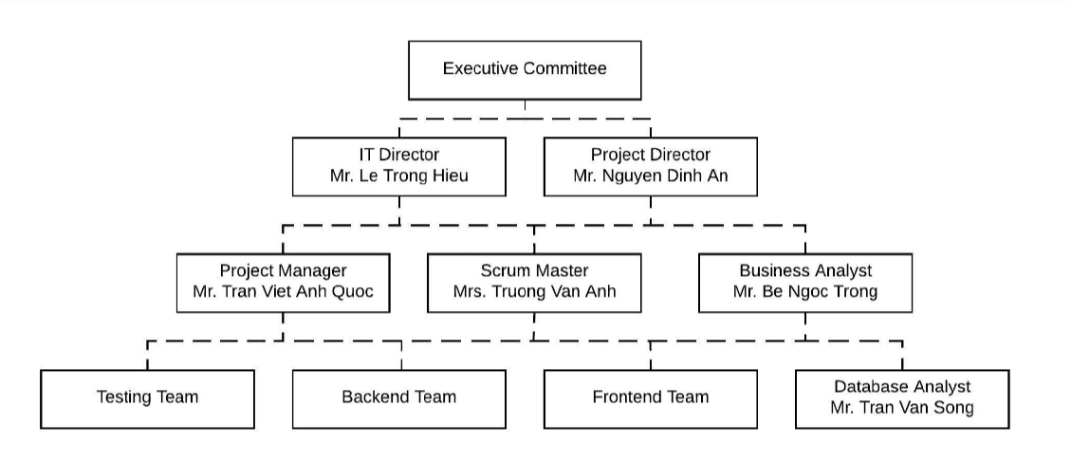
Section 2. Project Organization
Internal Structure
10/46

Slide 11
Section 2. Project Organization
External Stakeholders
Stakeholder Organization | Organization Description/Nature of Relationship | Stakeholder Name
Danang Government | Agency for licensing and authorizing projects | Government
Danang DoT | Direct customer of the company | Customer
Danang IIDC | The agency provides hardware and assists the company in product deployment | Supplier
11/46

Slide 12
Section 2. Project Organization
Roles and Responsibilities
Executive Committee
IT Director
Project Director
Project Manager
Scrum Master
Database Analyst
Business Analyst
Testing Team
12/46

Slide 13
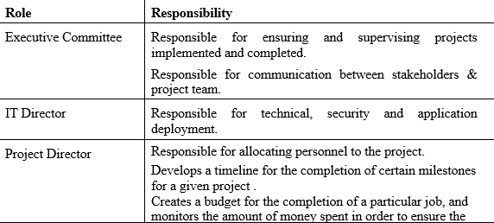
Section 2. Project Organization
Roles and Responsibilities
13/46

Slide 14
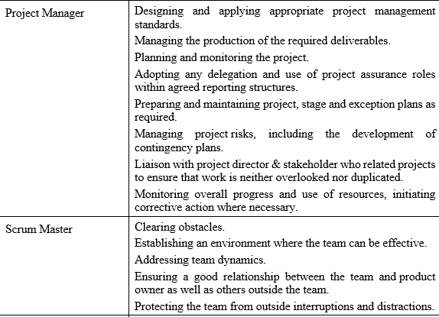
Section 2. Project Organization
Roles and Responsibilities
14/46

Slide 15
Section 3. Project Start-up
A
Project Life Cycle
E
Schedule Allocation
B
Methods, Tools, and Techniques
F
Resource Plan
C
Estimation Methods
G
Budget Allocation
D
Work Activites
15/46

Slide 16
Section 3. Project Start-up
Project Life Cycle
Devided into 6 phase
Phase 1: Conducted requirements
Phase 2: define software needs
Phase 3: Design
Phase 4: Coding
Phase 5: Installing/Deployment
Phase 6: Maintenance
16/46

Slide 17
Section 3. Project Start-up
Method, Tools, and Techniques
System Development Standards
Documentation Standards
Program Standards
Command File Standards
Test Case Standards
17/46

Slide 18
Section 3. Project Start-up
Estimation Methods
Description
Effort in person-months or person-hours
Schedule in calendar months
Budget in dollars
Source/Basis of Estimate
Level of Uncertainty
18/46

Slide 19
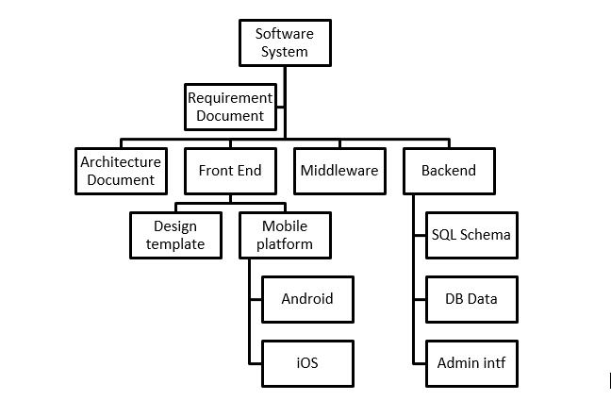
Section 3. Project Start-up
Work Activities
Product Work Breakdown Structure
19/46

Slide 20
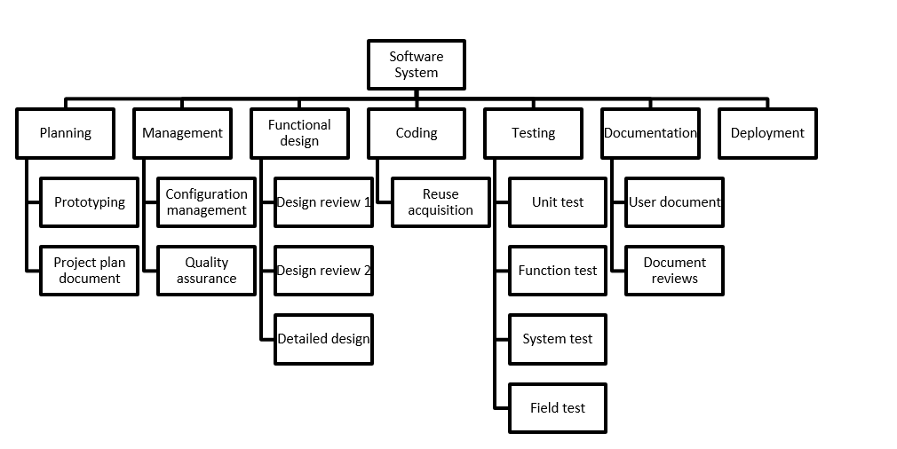
Section 3. Project Start-up
Work Activities
Process Work Breakdown Structure
20/46

Slide 21
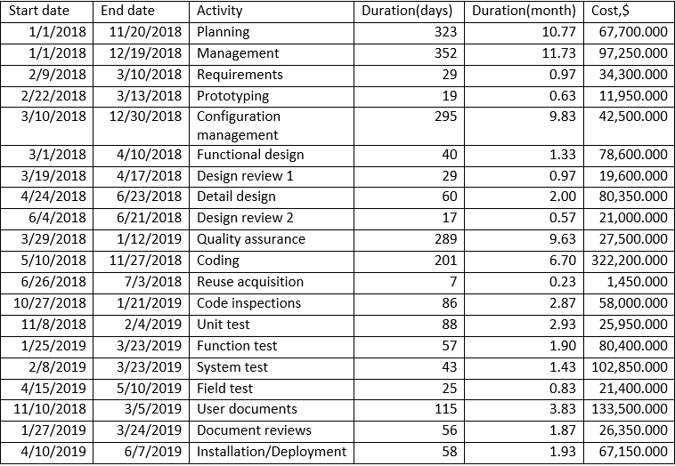
Section 3. Project Start-up
Schedule & Budget Allocation
21/46

Slide 22
Section 3. Project Start-up
Schedule & Budget Allocation
22/46

Slide 23
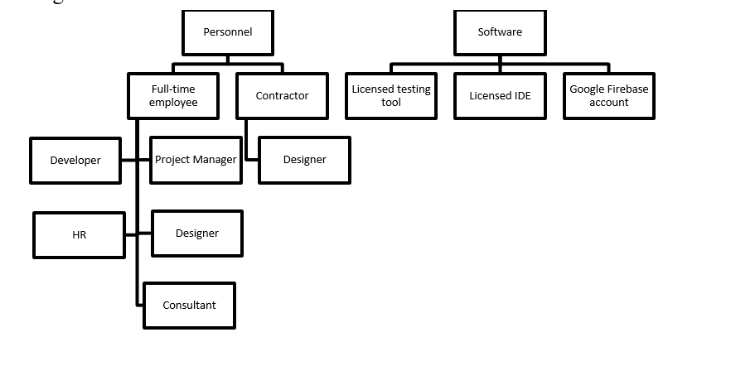
Section 3. Project Start-up
Resource Plan
Resource profiles
23/46

Slide 24
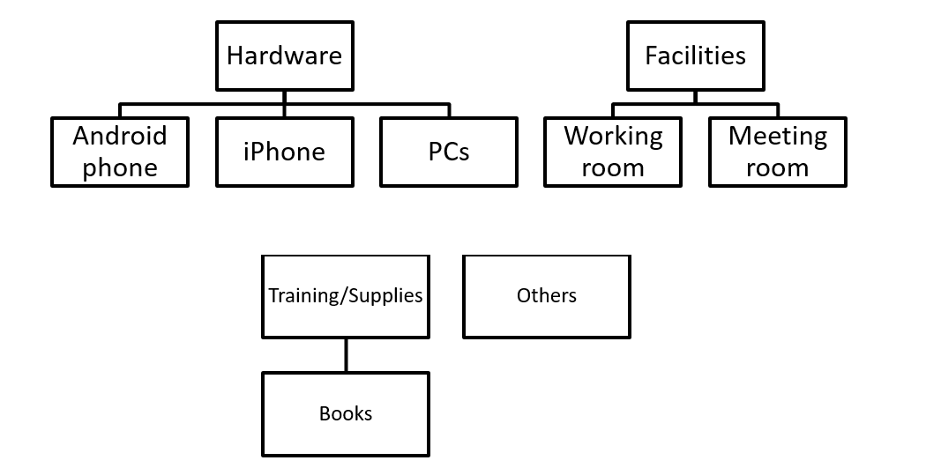
Section 3. Project Start-up
Resource Plan
Resource profiles
24/46

Slide 25
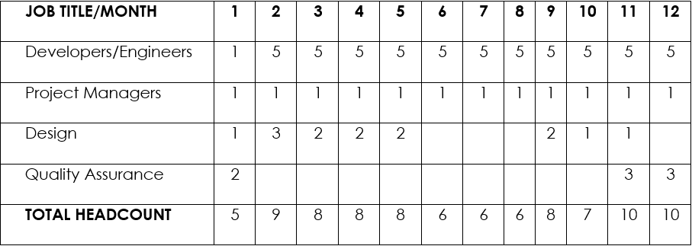
Section 3. Project Start-up
Resource Plan
Resource Staffing
25/46

Slide 26
Section 4. Monitoring and Control
A
Change Control
B
Issue Management
C
Status Reporting
C
26/46

Slide 27
Section 4. Monitoring and Control
Change Request Tracking
Managing a Scope Change Management.
Scope increase.
Unplanned Tasks.
Scope Decrease.
27/46

Slide 28
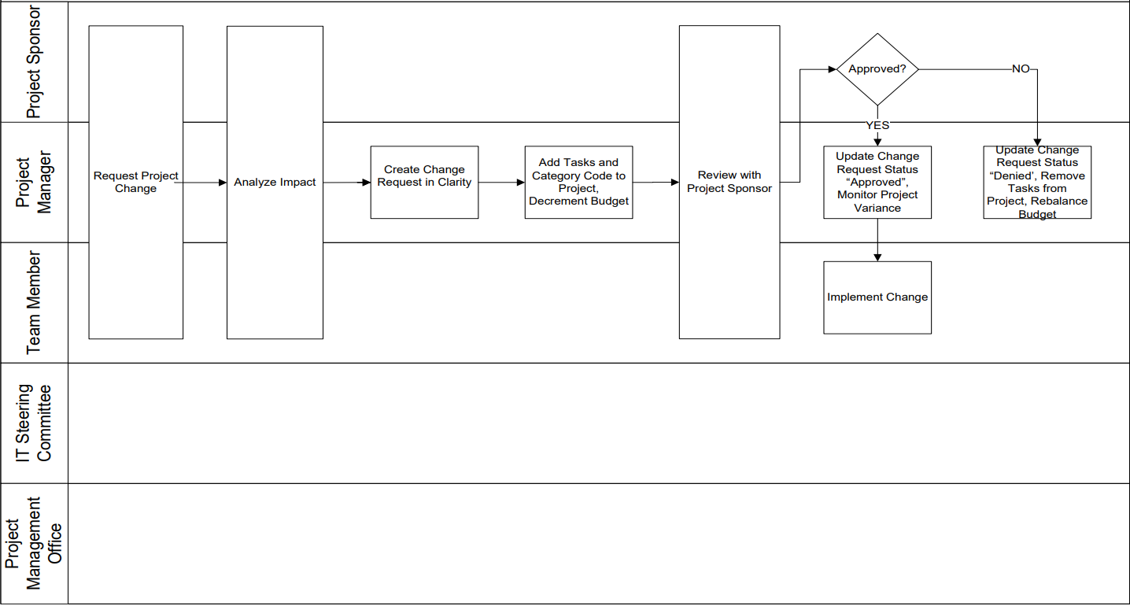
Section 4. Monitoring and Control
Change Request Tracking
Scope Change Management
28/46

Slide 29
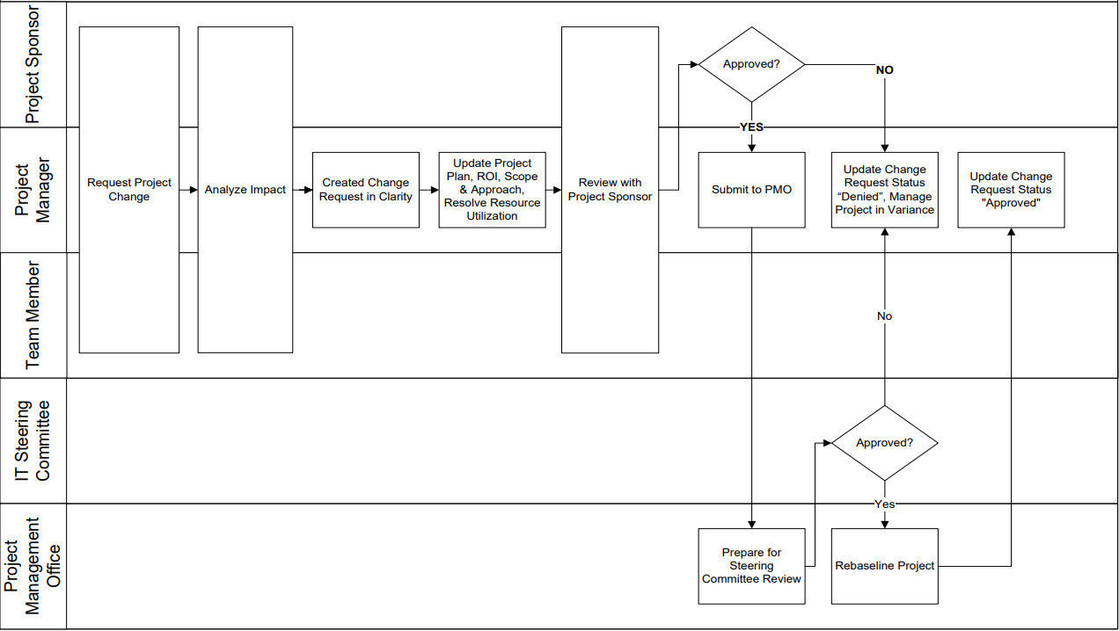
Section 4. Monitoring and Control
Change Request Tracking
Project Renegotiation
Impact on cost and project schedule
29/46

Slide 30
Section 4. Monitoring and Control
Change Request Review
Role | Person | Responsibility
Project Director | Mr. Nguyen Dinh An | Initiates a change request. Reviews and approves change requests.
Project Manager |  | Initiates a Change Request. Analyze the impact. Creates and maintains Change Requests in Clarity. Reviews and obtains approval. Project scope management Maintains the project plan.
Backend Team Testing Team Frontend Tem | All member in team | Initiates a Change Request. Analyzes the impact and Implements approved Change Requests.
IT Director Scrum Master | Mr. Le Trong Hieu Ms. Truong Thi Van Anh | Reviews and approve
Project Management Office | Mr. Cao Son Duc | Review and follow up. Monitors project variances.

Slide 31
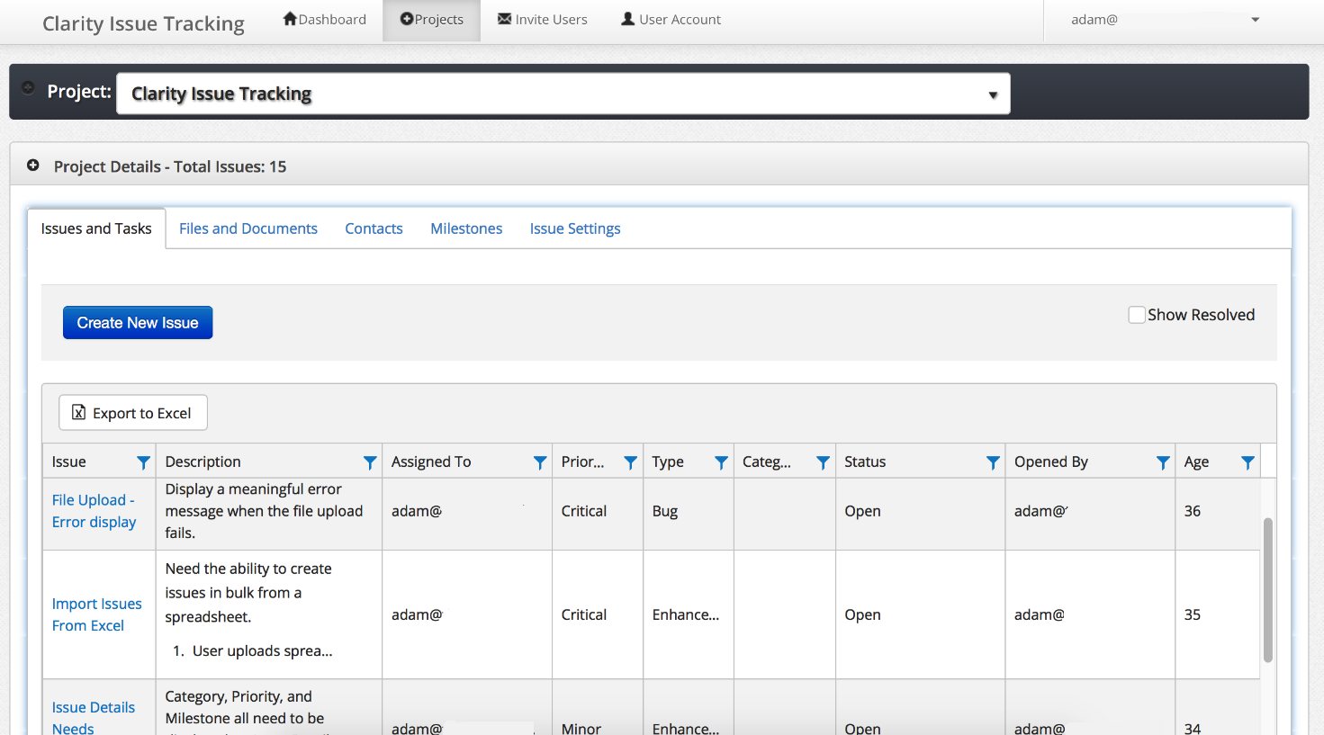
Issue Management
Use “clarity issue tracking” issue tracking software.
Detailed instruction about this software will be described in another documents.
31/46

Slide 32
Status Reporting
Field | Value
Change request ID | Business Justification
Change request Name | Entered name
Description | Summary description text
Requested by | Usually Project Manager
Status | Approved/Denied/Pending
Date | Date time
Reason | Approved/Denied reason
Comments | Other comments for clarification purpuse
Deliverables Impacted | Enter in any deliverables that will be impacted
Business Justification | Enter the business justification for the Project Change Request.
32/46

Slide 33
Section 5. Quality Management
A
Quality Objectives
Quality Standards
B
C
Project Reviews and Assessments
D
Deliverables Acceptance
E
Prosess Improvement Activities
33/46

Slide 34
Section 5. Quality Management
Quality Objectives
The DanaBus Application Plan identifies three brief goal.
All of main features: find optimal bus route, find bus stop, bus schedule details, estimate waiting time and feedback must be available.
Help users get the best experience when using the bus service.
The application must meet the target of 3.5/5 stars or receive over 100 feedbacks from users on the App Store and Google Play Store.
34/46

Slide 35
Section 5. Quality Management
Quality Standards
No. | Quality Standards | Tracking Tools or Measures
1 | Six Sigma | Redmine, Jira, clarity issue tracking
2 | IEEE 12207-2017 – ISO/IEC/IEEE | Redmine, clarity issue tracking
3 | AHAQ Coding Convention | GitHub, Jira, clarity issue tracking
35/46

Slide 36
Project Reviews and Assessments
Review Type | Quality Standard | Tools | Reviewer | Reports
Project Report | Six Sigma | Redmine Jira clarity issue tracking | IT Director Project Director Executive Committee Project Manager Stakeholders | Review Report
Project Audit | Six Sigma | Redmine Jira | Business Analyst Project Manager Project Director Executive Committee | Audit Report
Daily Review | AHAQ Coding Convention | GitHub Jira clarity issue tracking | Backend Team Frontend Team Testing Team Database Analyst Project Manager Scrum Master IT Director | Individual Report
Quality Review | Six Sigma | Redmine Jira clarity issue tracking | Testing Team Business Analyst Project Manager Scrum Master Project Director | Quality Report
36/46

Slide 37
Deliverables Acceptance
Deliverable | Fimal Approval Process | Customer Acceptance Criteria
Requirements document | Requirements | The requirements that customer give are fully described.
Design drawings and documents | Design review 1 Design review 2 Detail Design | - Design and documents that meet the requirements. - Customer satisfy about UI pattern.
Project plan | Planning Management | - The stages are properly deployed. - The budget does not exceed the allowable level. - Products are delivered on given time.
Product prototype | Prototyping | The prototype is standardized with design.
Beta version application “DanaBus” | Installation Deployment | All of main features must be available.
Completed application “DanaBus” | Installation Deployment | - All of main features must be available. - The product operates smoothly and there are no major errors.
User document | User document | - Full description of the application. - Future maintenance and development capabilities
37/46

Slide 38
Section 5. Quality Management
Project Monthly Report
Participants: IT Director, Project Director, Executive Committee, Project Manager, Stakeholders.
Activities: Often a monthly status report is provided to the stakeholder and executive committee as an update of employee’s plans and activities.
Goal: Provides a higher-level view of the developments in the project.
38/46

Slide 39
Section 5. Quality Management
Daily Review
Participants: Project Manager, Backend Team, Frontend Team, Testing Team, Database Analyst, Business Analyst, IT Director
Activities: Discuss and review the day's work among members.
Goal: Identify issues, ability to complete tasks and propose methods to complete each stage of the project.
39/46

Slide 40
Section 6. Project Transition
Closeout Plan
Include 3 phases:
Phase 1: Create all the needed document about this project (including Project Close Out Report).
Phase 2: Handover the management process to city’s departement of transport.
Phase 3: The whole team is in “waiting state” for maintenance purposes.
40/46

Slide 41
Section 6. Project Transition
Phase Closeout
The current contract between our company and city’s government is lasting 5 years. So Phase 2 will close after 5 years if there are no new renew contract request from the customer.
41/46

Slide 42
Section 7. References
Document No. | Document Title | Date | Author
1 | Information Technology Project Management 6th | 2011 | Kathy Schwalbe
2 | Project Structure and Organisation | N/A | N/A
3 | What is PERT and how can we use it? | 2015 | Dave Fourie
4 | V-model wiki | 2019 | N/A
5 | Oakland County Department of Information Technology | N/A | Oakland County Department of Information Technology
42/46

Slide 43
Section 8. Glossary
Abbreviation
DoT | Department of Transportation
Danang IIDC | Danang ICT Infrastructure Development Center
SDLC | Software Development Life Cycle
PERT | Project Evaluation and Review Technique
FTE | Full-Time Employed
TMF | Toyota Mobility Foundation
43/46

Slide 44
Section 8. Glossary
Glossary
Assumption | Factors deemed to be true during the project planning process, though proof of their validity is not available.
Baseline | This term represent the costs and schedules approved at the start of the project.
Budget | The sum of money allocated for a project
Change control | Change control is the process of identifying, evaluating, approving, and implementing changes to a project.
Change management plan | It is created to ensure all changes are managed according to procedure.
Critical path activity | A scheduled activity that is part of a project’s critical path.
44/46

Slide 45
Section 9. Revision History
Version | Date | Name | Description
1st | 2019, March 15th | Project Initiation | Identify project scope, assumption, constraints,...
2nd | 2019, April 12th | Project Start | Complete Project Plan
45/46

Slide 46


